Slide 1





TERM PROJECT
CIS 476
Dorah Mohamed

Slide 2




BACKGROUND
For this project, I developed MyPass, a password management software, focusing on core features like secure login, password generation, and data storage. I ended up creating four key features (required 2-3) since I chose to work individually; features include user registration/login feature, password generation, weak password checker, a secure vault for storing sensitive data, feature to add, edit, delete vault items. MyPass is designed to offer users a reliable and user-friendly way to manage passwords and sensitive information securely and conveniently.

Slide 3



FEATURES IMPLEMENTED
1
2
User Registration
/Login
Weak Password Warning
3
4
Password
Generator
Create, Edit, Delete Vault items

Slide 4
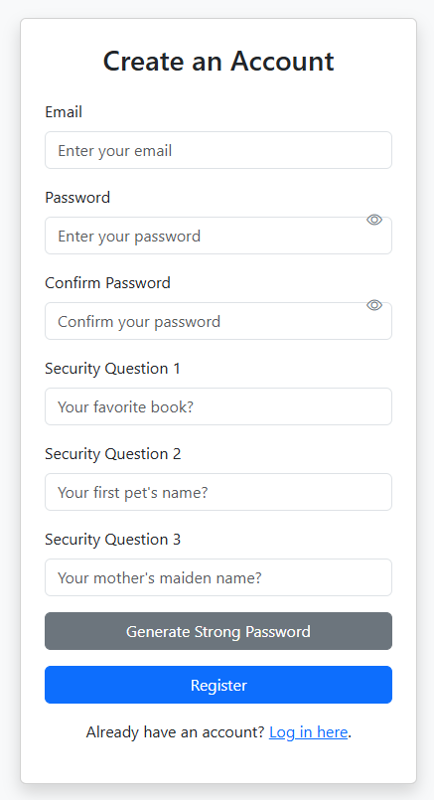
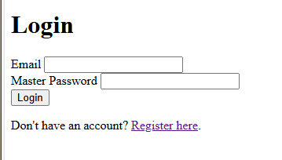
USER REGISTRATION & LOGIN
User email
Password (Option to select suggested)
3 Security Questions
Option to redirect to login page.

Slide 5
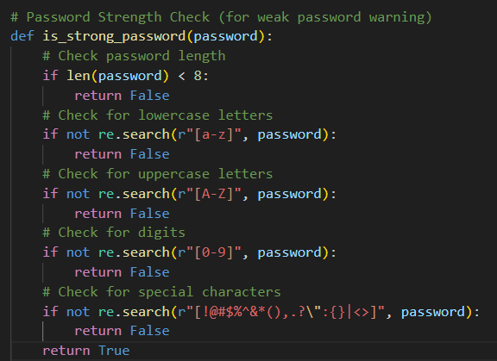
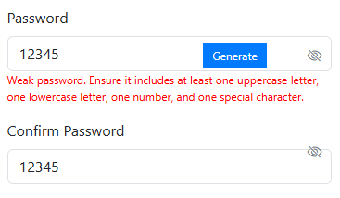
WEAK PASSWORD WARNING
User password must follow these conditions otherwise it will warn the user.

Slide 6
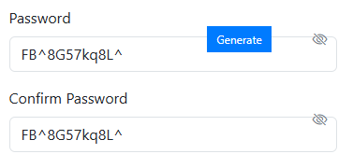
PASSWORD GENERATOR
follows the same conditions and generates a password

Slide 7
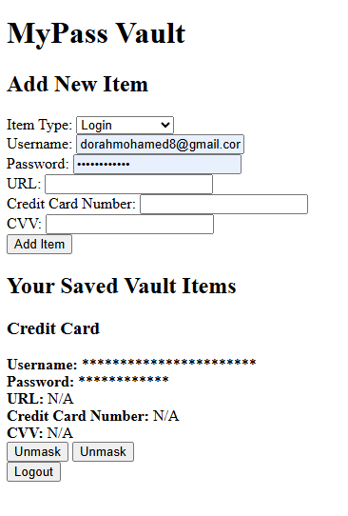
VAULT ACCESS
A user with access can create Items in VAULT
01.
02.
A user with access can edit Items in VAULT
03.
A user with access can delete Items in VAULT

Slide 8
DESIGN EXPLANATION
Flask: Web framework for building the application (handles routing, sessions, etc.)
Flask-SQLAlchemy: Interface to interact with the SQL database using SQLAlchemy ORM for managing the database models.
Flask-WTF: Form handling and validation for the user registration and login forms.
Flask-Session: Manages user sessions, allowing user data to persist between requests.

Slide 9
DESIGN EXPLANATION
SQLAlchemy: ORM for interacting with the relational database (used for defining user models and handling database queries).
Werkzeug: Provides utilities for password hashing (used for securely storing passwords).

Slide 10
DEMO & CODE EXPLANATION

Slide 11
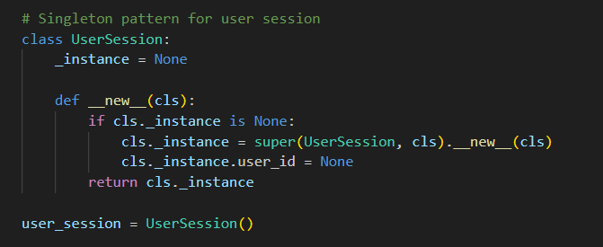
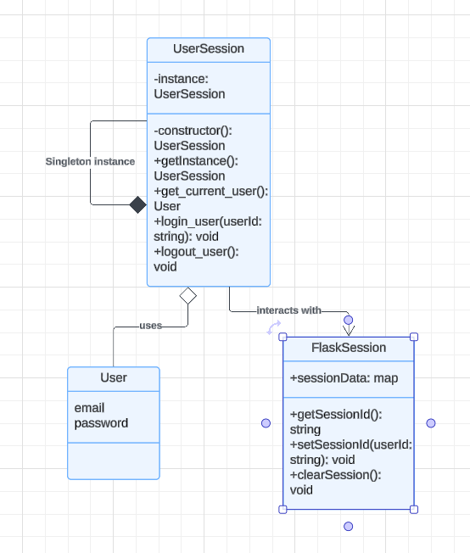
DESIGN PATTERN EXPLANATION
1
Singleton Pattern
The Singleton pattern is used to ensure that only one instance of the user session exists throughout the application. In my application, the user session is managed by the app.py file where user authentication takes place. By utilizing Flask's session management system, I ensure that once a user is authenticated, the session persists across multiple requests without creating multiple session objects.

Slide 12
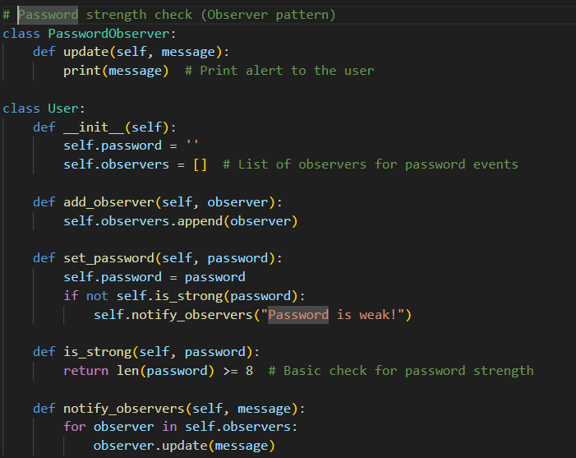
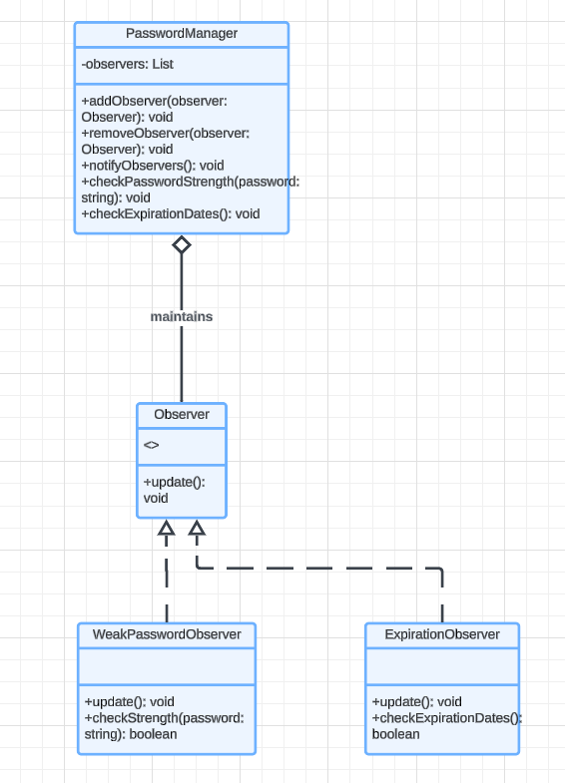
DESIGN PATTERN EXPLANATION
2
Observer Pattern
The Observer pattern is used to notify users when certain events, like weak passwords or expiring credentials (credit card, passport, license), occur. This pattern enables the application to alert users to take necessary actions.
Whenever a password is set or updated, the application checks its strength. If the password is weak or expires, it triggers an observer notification, which alerts the user to correct it.

Slide 13
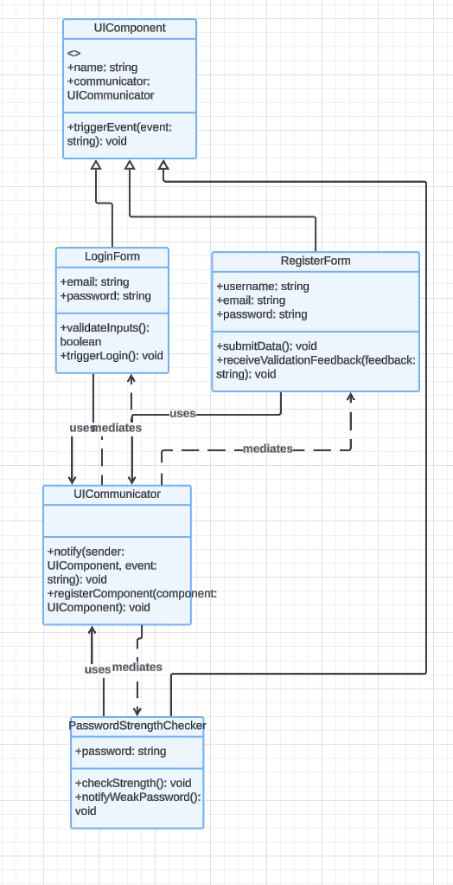
DESIGN PATTERN EXPLANATION
3
Mediator Pattern
The Mediator pattern is used to manage communication between various UI components. In this case, it ensures that components like the form inputs and buttons are not tightly coupled and can interact in a coordinated way through a central mediator.
In my application, FormMediator class handles all interactions between form elements and actions such as registration and login. This pattern helps keep the UI components loosely coupled and promotes reusability.

Slide 14
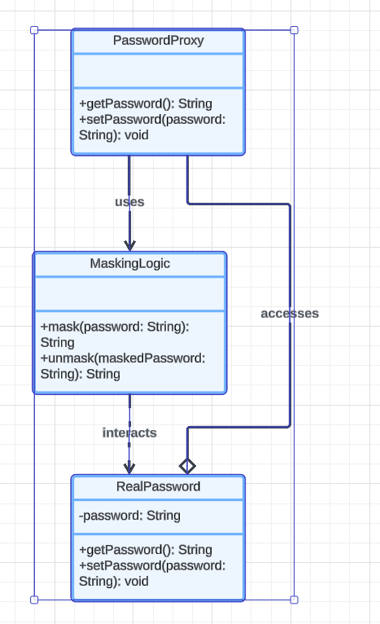
DESIGN PATTERN EXPLANATION
3
Proxy Pattern
The Proxy pattern is implemented to manage access to sensitive data, such as passwords. A proxy is used to mask sensitive data when it is not needed and unmask it when access is authorized. My PasswordProxy class that handles the masking and unmasking of sensitive data based on user permissions.

Slide 15
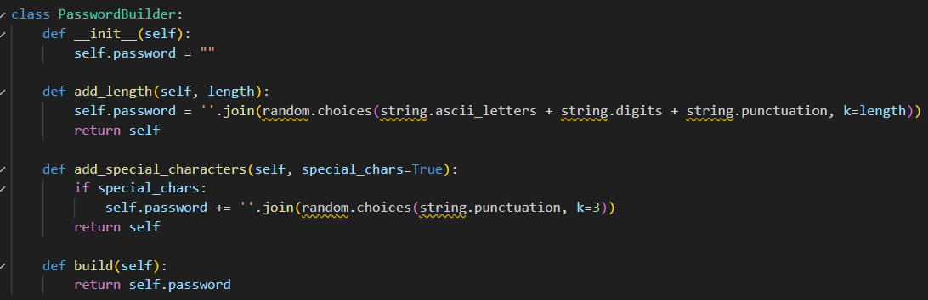
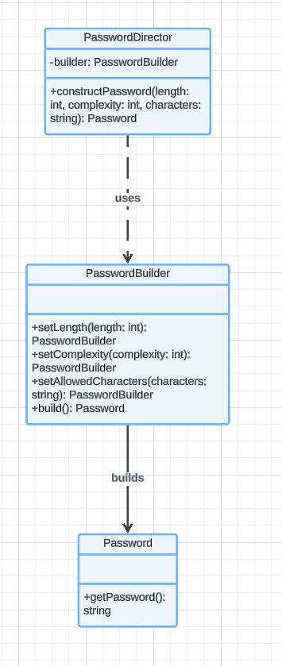
DESIGN PATTERN EXPLANATION
4
Builder Pattern
The Builder pattern is applied to generate complex passwords that meet specific requirements (length, complexity). It allows for the creation of a password step-by-step, ensuring that all criteria are met.
PasswordBuilder class facilitates password generation by adding complexity features like length, special characters, numbers, and upper/lowercase letters.

Slide 16

THANK YOU

